Slide 1


Kaggle Mavericks
Unleashing your Inner Data Science
Waiz Wafiq
11th November 2023
The Cubes, Block A Faculty of Computer Science & Information Technology, UM

Slide 2
Workshop Tentative
Saturday 11/11/2023 | Time | Activity
 | 10:10 am – 10:20 am | Introduction
 | 10:20 am – 12:10 pm | Workshop Session 1
 | 12:10 pm – 1:10 pm | Lunch Break!
 | 1:10pm – 2:45pm | Workshop Session 2
 | 2:45 pm – 3:00 pm | Workshop Ends; Photo Session

Slide 3

QnA – Slido Link
https://qrco.de/beXIuo

Slide 4
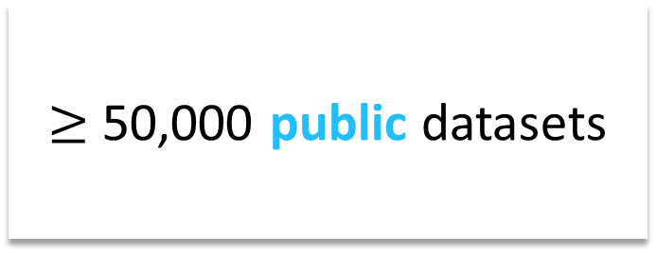
What is Kaggle?
The popular platform for
data science competitions
$≥$ 50,000 public datasets
Industry-related;
Also suitable for
computer vision

Slide 5
Our Objectives
free lunch la aiyo

Slide 6
Our Objectives
Equip participants with a solid understanding of exploratory data analysis
(EDA) techniques and descriptive analysis to
unveil patterns, trends, and insights within datasets.
Enable participants to effectively choose and engineer features that significantly impact model performance.
Delve into predictive analytics, guiding participants
through the process of building machine learning models.

Slide 7
Can Kaggle help become a data scientist?
✅ YES
❌ NO
A good approach to real-life problems
Learn new libraries in R or Python
Learn from the Kaggle community sharing their explorations/solutions
Skips data collection
Overemphasis on the machine learning part of data science, which is a minority part of the job

Slide 8
General Data Science Process
“Turn data into insights”
Data Collection
Data Preparation
Data Cleaning and Wrangling
EDA
Model Training
Model Evaluation & Selection
Content Delivery
Continuous Iteration

Slide 9
The Kaggle Process
“Turn data into prediction”
Session 2
Data Cleaning and Wrangling
EDA
Model Training
Model Evaluation & Selection
Content Delivery
Continuous Iteration
Data Collection
Data Preparation
Session 1

Slide 10
Session 1

Slide 11
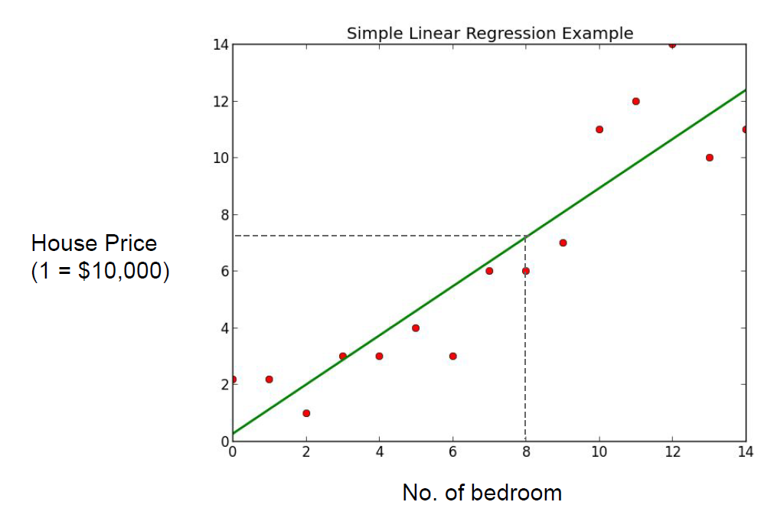
Supervised Learning
Regression Problem!

Slide 12
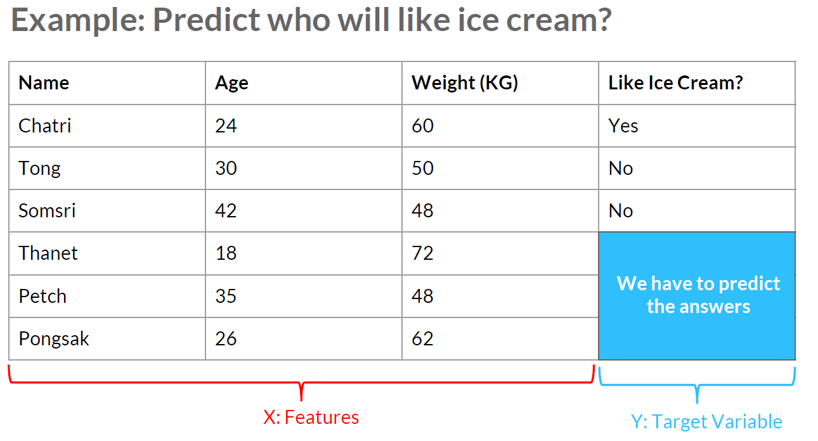
Supervised Learning
Abu
Sofiyya
Zamru
Classification Problem!
Chua
Jason
Lisa

Slide 13
Introduction to Data Wrangling
The process of converting raw data into a usable form.
Abu
Sofiyya
30.56
no
Zamru
Chua
Jason
Lisa

Slide 14
Data Wrangling – Workflow Goals
1. Correlating
2. Completing
3. Correcting
4. Creating
Exploratory Data Analysis (EDA)

Slide 15
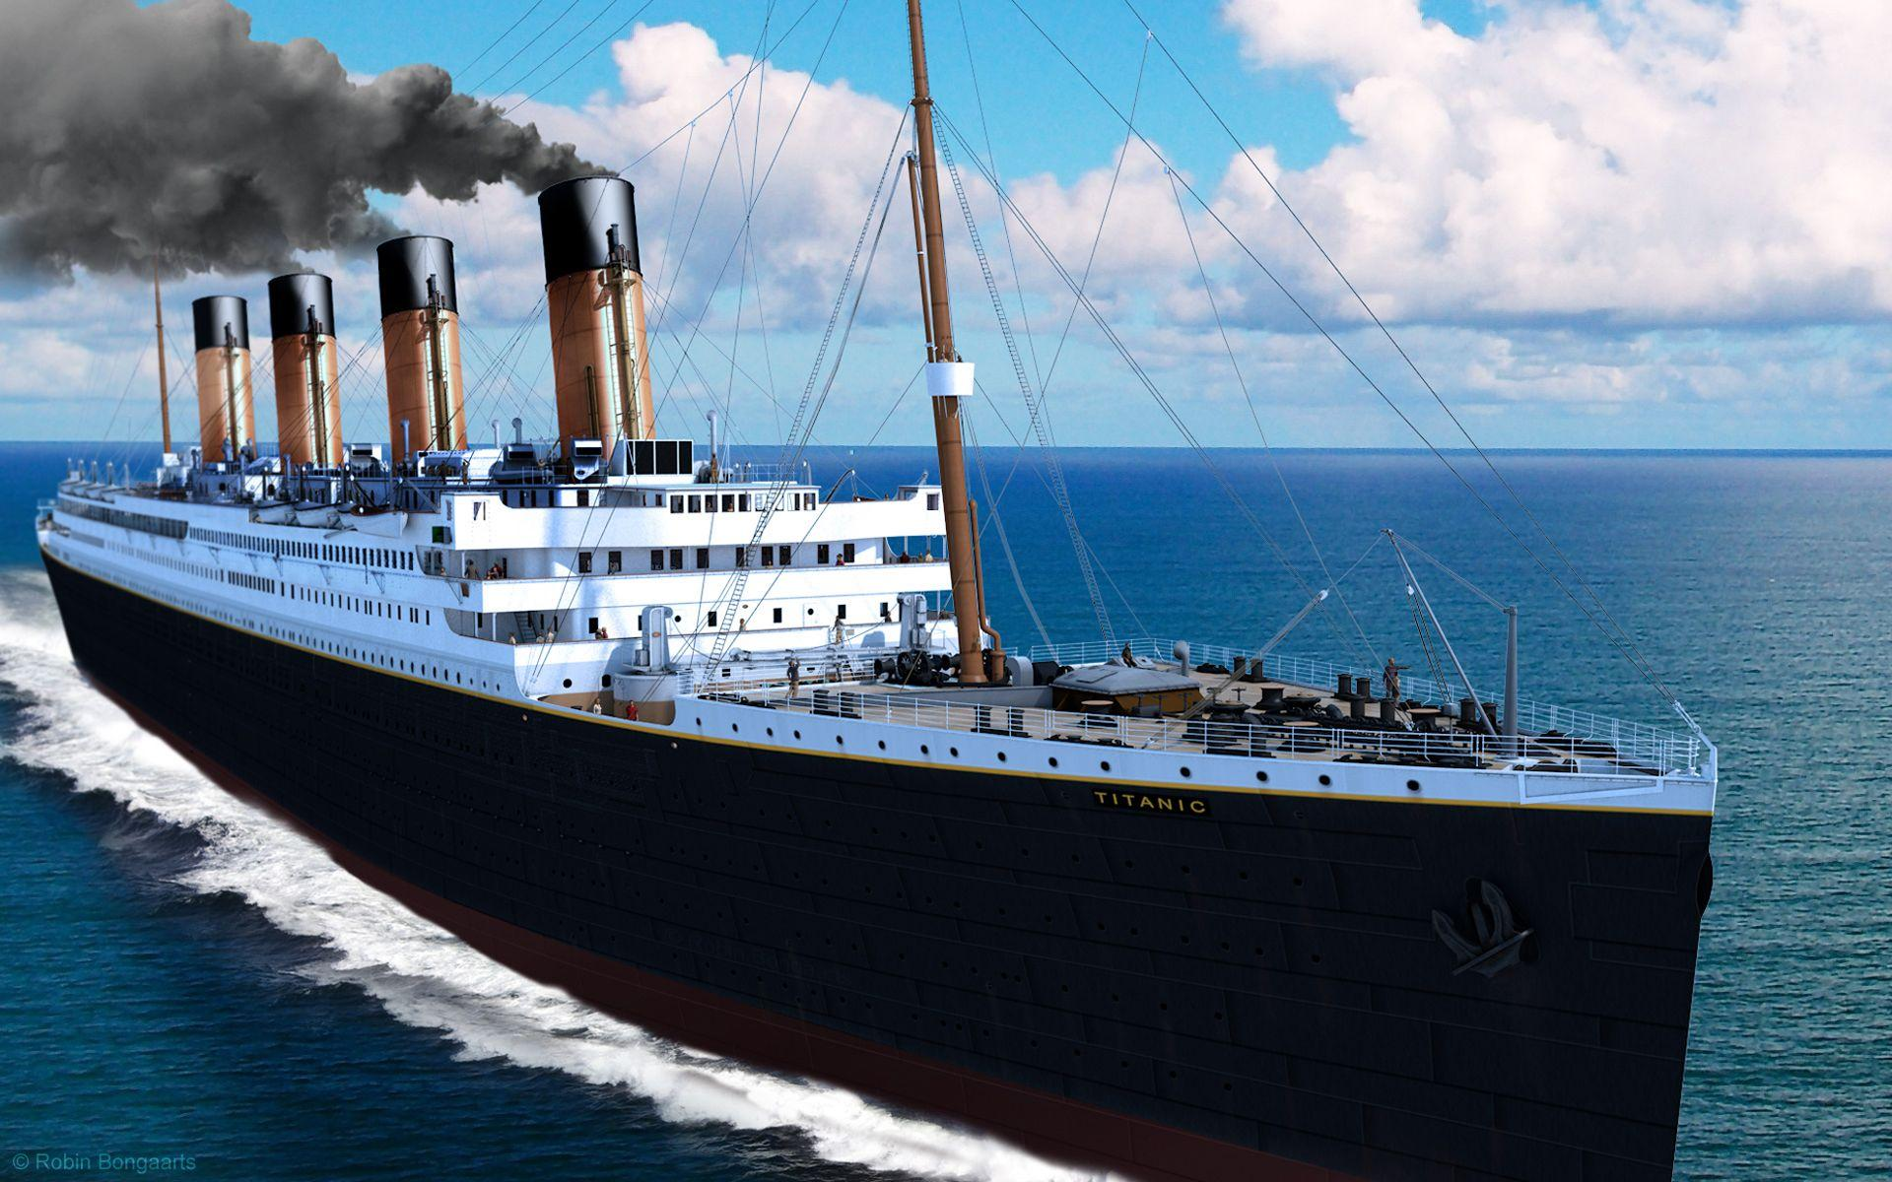
The Titanic Survival Dataset
Question: Who will survive the Titanic?
Context:
On 15th April 1912, the Titanic sank after colliding with an iceberg, killing 1502 out of 2224 passengers and crews. (32.46% survival rate)
There were lack of lifeboats for the passengers and crews.
Some groups of people are more likely to survive than others, such as women, children, and the upper-class.

Slide 16
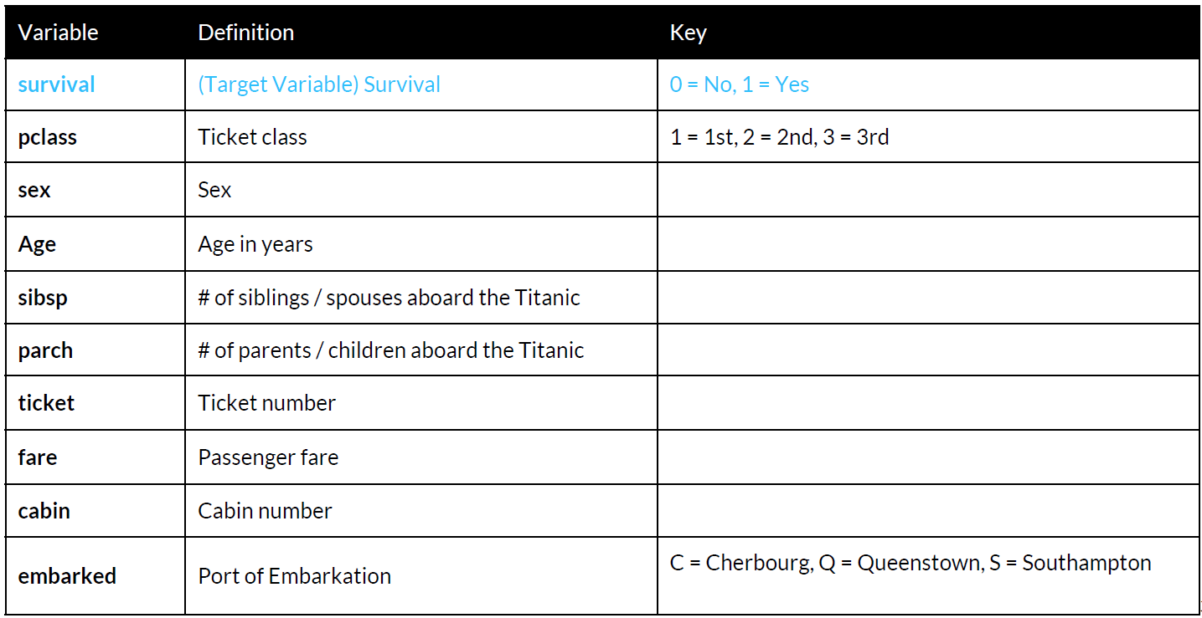
Titanic: Data Dictionary

Slide 17
Which features are categorical?
Which features are numerical?

Slide 18
Categorical Data
categorical
ordinal

Slide 19
Numerical Data
discrete
continuous

Slide 20
Coding Time!

Slide 21
QnA – Slido Link
https://qrco.de/beXIuo

Slide 22
Lunch Break
See you guys at 1:10 pm!

Slide 23
Session 2

Slide 24
Data needs to be split
Training Data
(train.csv)
Full Data
70%
30%
Testing Data
(test.csv)

Slide 25
Building a Predictive Model
Testing Data
(test.csv)
.predict()
Model
Prediction Results
Training Data
(train.csv)
.fit()
.score()

Slide 26
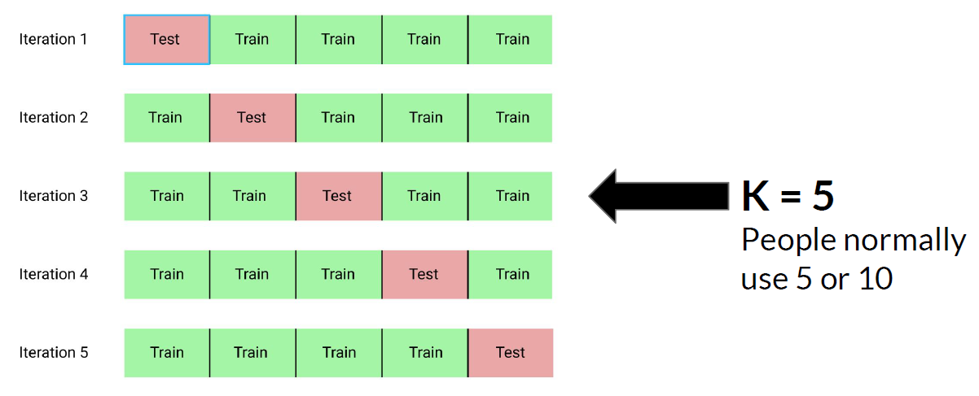
K-Fold Cross Validation

Slide 27
Coding Time!

Slide 28
QnA – Slido Link
https://qrco.de/beXIuo

Slide 29
Thank you!

